Slide 1
Billiards Trajectories
John Mikulskis

Slide 2
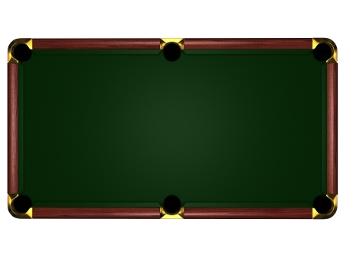

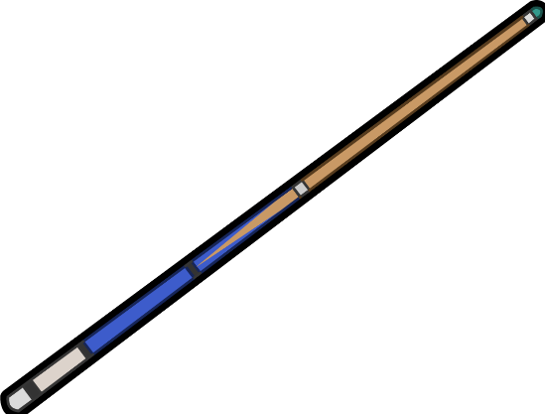
Introduction
Billiards has existed for several hundred years
8 ball pool, English snooker, 3 cushion, 9 ball, etc.
m
n

Slide 3
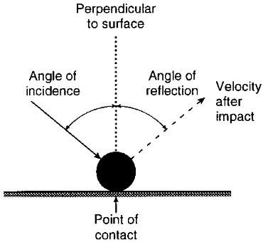
Some Rules
Bounces follow the law of optics
All energy is conserved
No spin on the ball
Ball has no volume
Cannot get “stuck” at corners

Slide 4
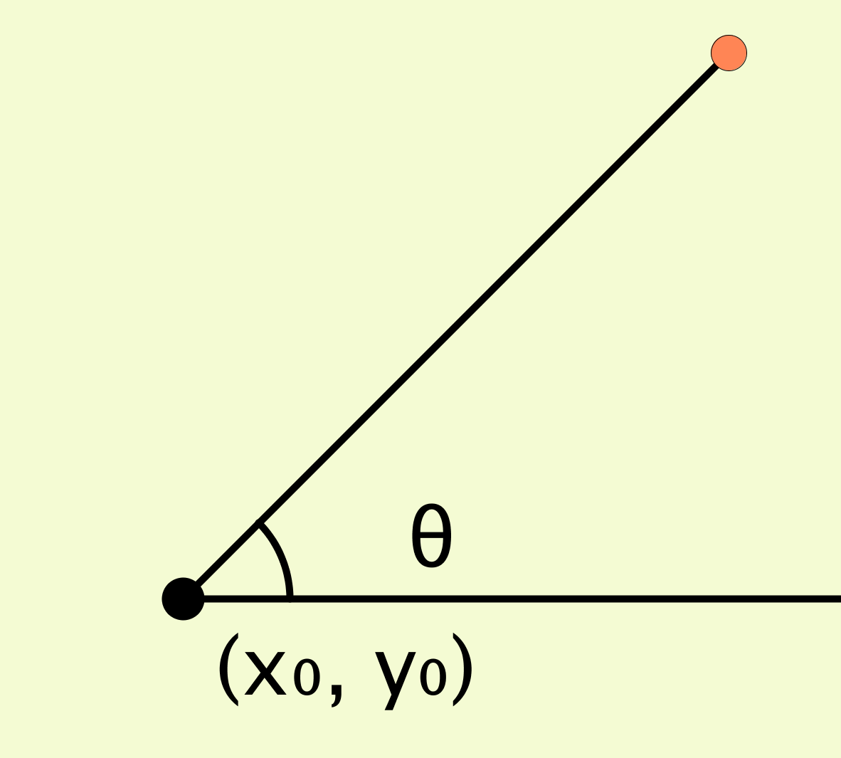
Table of [m x n] : m, n ∈ Z +
Can start off trying standard projectile motion analysis
Vector with components for horizontal speed + vertical speed
Speed does not matter, so we
can just consider θ

Slide 5
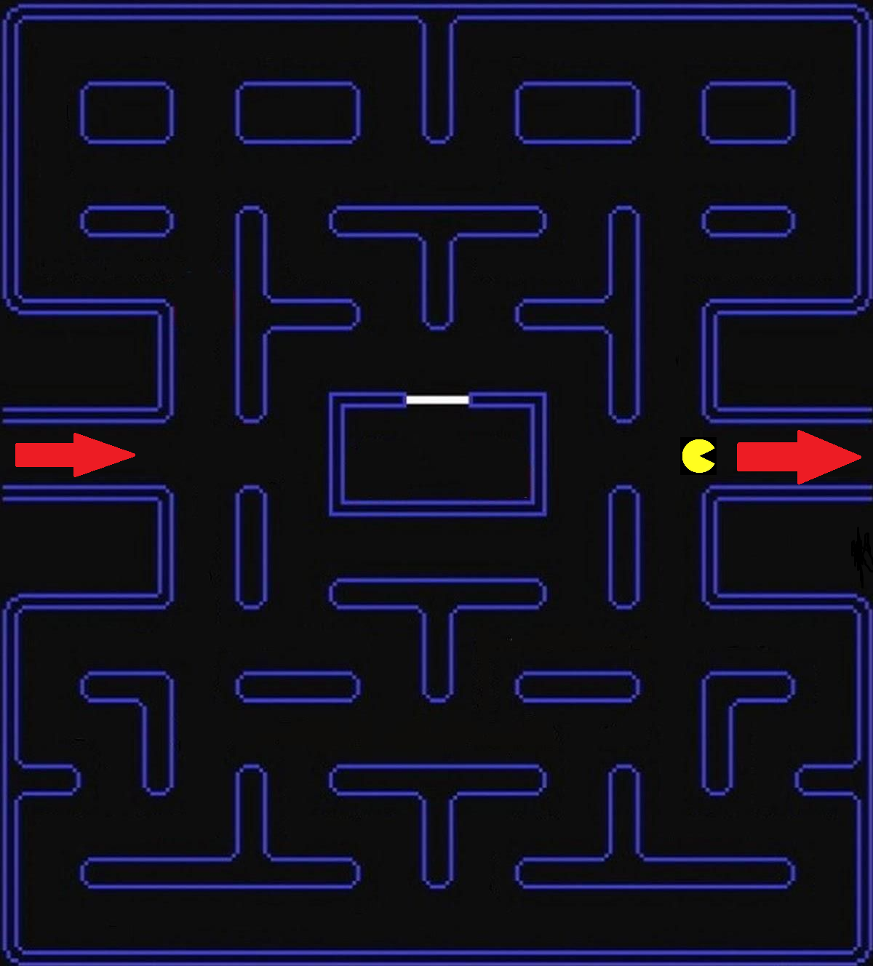
Challenges
It’s hard to analyze trajectories that bounce
We can start off by looking at a simpler form…”pacman” version

Slide 6
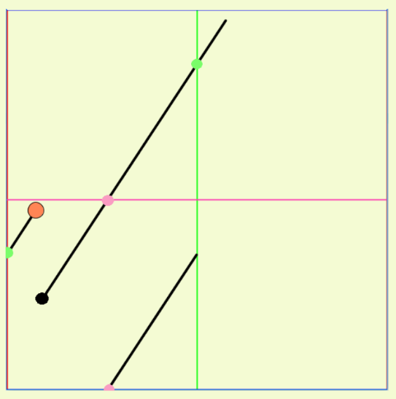
Duplicated Table Analysis

Slide 7
Closed Path Analysis
A path is “closed” if it returns back to its starting position at the same θ

Slide 8
Closed Path Analysis
Every point that the initial path goes through in a duplicated table, it also goes through in the actual table
Can find which paths go through the starting point in the duplicated tables
θ never changes, so if it goes through the starting point, then the path will be closed

Slide 9
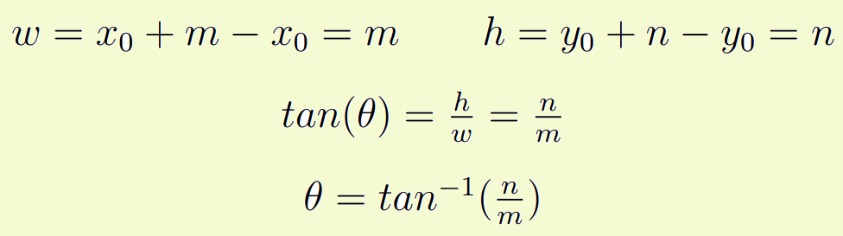
Finding θ for a path that closes up
The angle of the closed path is not dependent on the starting point

Slide 10
This θ is not unique

